Slide 1

User description id 96
User's personal information and transactions

Slide 2
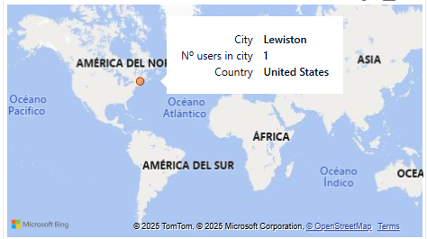
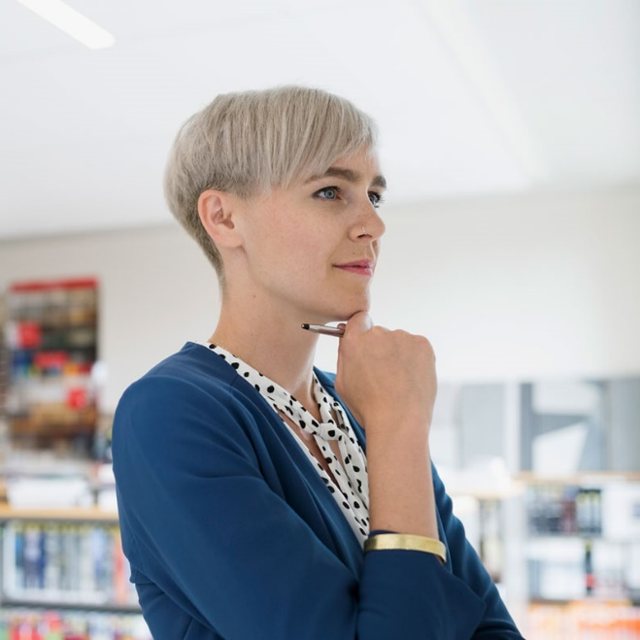



User information
Brennan Wynn
ID 96 | 37 years old
nullam.ut@yahoo.net
(831) 607 3574

Slide 3
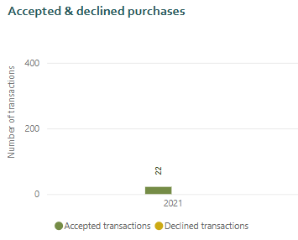
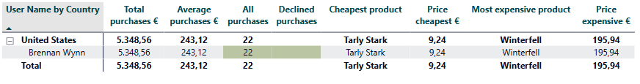
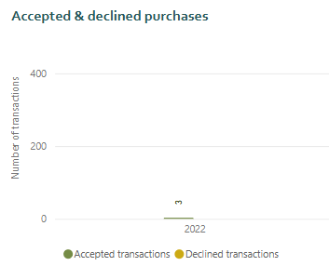
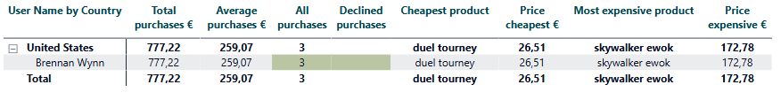
Total purchases
2021
22 purchases accepted with a total value of 5,348.56 €
2022
3 purchases accepted with a total value of 259.07 €

Slide 4
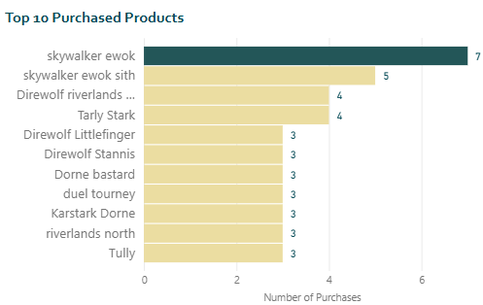
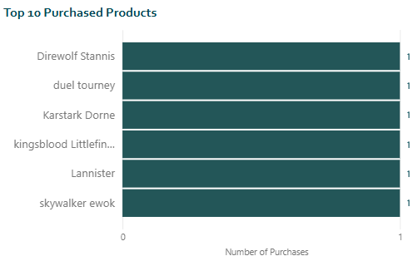
Purchased products – top 10
2021
2022
The most purchased product was skywalker ewok with a total of 7 purchases.
6 products were purchased only once.

